Slide 1
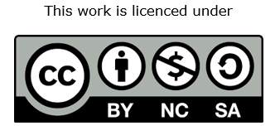
Erasmus+ Project “#respACT – Activating VET teachers to counter hate speech and cyberbullying” n° 2020-1-DE02-KA202-007716 #ACTonCyberbullying
The European Commission support for the production of this publication does not constitute an endorsement of the contents which reflects the view only of the authors, and the Commission cannot be held responsible for any use which may be made of the information contained therein.

Slide 2
Let’s break the ice!
Every name has a story, every story has a name!
For this first activity, participants are invited to take turns saying their name and telling their meaning – a way to begin to reflect on how different everyone‘s stories are.
Notes:
As an alternative, if participants do not know the meaning of their name, they can say why that specific name was chosen for them

Slide 3
What is cyberbullying?
Let‘s take turns sharing our idea on the topic, also sharing any suggestions coming to our minds (movies, books, discussions, social content…).
Notes:
This is an useful activity to get a general idea of the previous knowledge of the participants on the topic

Slide 4
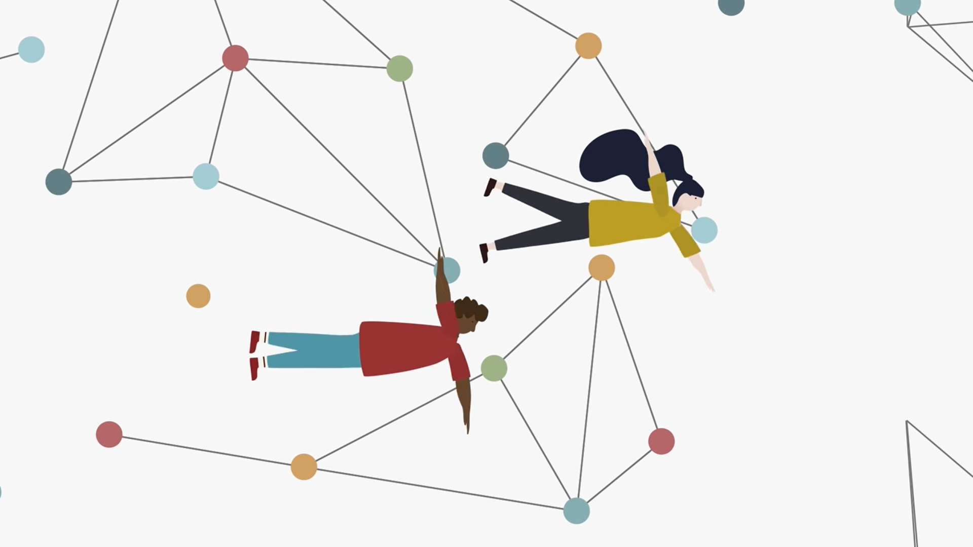
https://www.youtube.com/watch?v=56ZM9nD--_c
Learning to swim in this universe:
Cyberbullying explained well
Notes:
The audio of the video is in italian, however, automatic subtitels in english can be set

Slide 5
What is cyberbullying?
What is the purpose of the attacks?
Can it have serious consequences? Which ones?
What relationship do victim and aggressor have?
How is it different from "offline" bullying?"
Who can become a cyberbully?
Why does one become a cyberbully?
When and where can attacks occur?
Should one stop using the Internet altogether or ban it?
Who can stop the attacks?
Notes:
These questions are useful both to summarize what was seen in the video and to initiate discussion about what was seen: they can be asked either before or after watching

Slide 6
There are several different kinds of cyberbullying:
Exclusion: the cyberbully tries to alienate your friends, or make your peer group mock or hate you, leaving you alone and vulnerable.
Peer pressure: the cyberbully tries to get you to do or say things that you don’t want to do or say, by telling you that the other do that or by suggesting that, if you don’t do that, you won’t fit in.
Stalking: the cyberbully follows you on all your social media and gives you unwanted attention
A phenomenon with many faces

Slide 7
Physical bullying: if the cyberbully knows you in real life, he (or she) can combine cyberbullying with physical or social bullying.
Blackmail: the cyberbully threatens to reveal confidential information about you that would be embarrassing or even harmful to you.
Destroy web reputation: the cyberbully will stop at nothing to destroy as much of your virtual identity as possible, and usually hopes to destroy your real life as well.
A phenomenon with many faces

Slide 8
What is cyberbullying according to the law?
Please add the law/s relating to cyberbullying in your own country.
Notes:
On this slide, please add the law/s relating to cyberbullying in your own country.

Slide 9
Hate speech and bullying: what’s the difference?

Slide 10
Forum di Prevenzione - Bolzano (ITA)
The Bolzano Prevention Forum website is a useful portal for finding information on cyberbullying and other issues that can affect young people-and beyond.
The forum is also a promoter of the Digitale è reale (Virtual is real) campaign, which promotes best practices to prevent and address hate online.
To learn more

Slide 11
For ethical and conscious use of the web: the example of Social Warning
Social Warning – digital ethics movement is a movement that aims to make the digital world a more livable space. It is run by volunteers, who offer free educational meetings in which they invite students (and parents) to reflect on their rights in the digital world, but also on their responsibilities as „digital citizen“ and to be aware of the risks of misuse of the Internet.

Slide 12
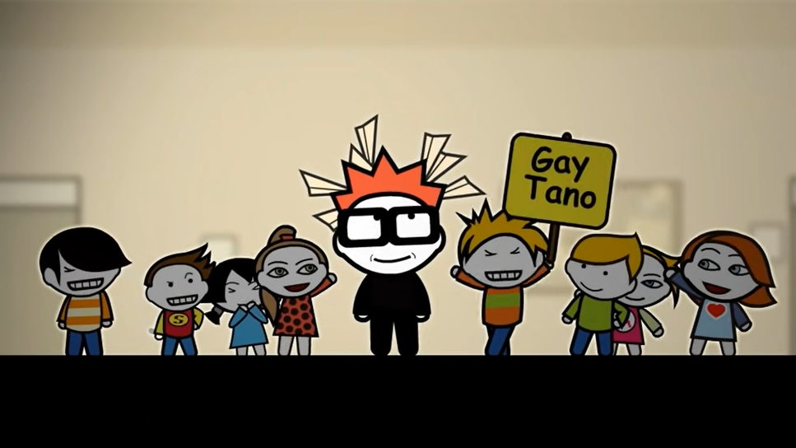
Gaetano: stories of ordinary cyberbullying
Let’s watch the video!

Slide 13
Who are the main characters in the video?
How is Gaetano's behavior interpreted?
How does the girl protagonist of the first half of the video judge her own behavior?
How does Gaetano actually?
How does Gaetano see himself?
What could Gaetano’s classmate do to cope with the situation?
What could Gaetano do to deal with his own situation?
Notes:
These questions are useful both to summarize what was seen in the video and to initiate discussion about what was seen: they can be asked either before or after watching

Slide 14
Let's imagine that we need to create a WhatsApp group for the class. Participants are asked to take turns to share what they think are the most annoying behaviors that should be avoided.
Why are these behaviors annoying?
What are the dangers of this type of communication?
A shared set of ten rules for the correct use of the chat is drafted for using WhatsApp chat effectively and calmly.
Some questions:
Are these rules necessary?
Who will be in charge of ensuring that the rules are followed?
What happens if they are not respected?
A practical example: let’s create a WhatsApp chat for the class
Notes:
If the training is delivered online, we suggest to use tools as Jamboard or Mentimeter

Slide 15
Parole ostili
Parole Ostili (hostile words) is a social project to raise awareness against the violence of words.
It works to prevent online hate in various areas and with various activities, with information materials and educational paths aimed at schools, as well as politics, business and the sports world.
The spirit of Parole Ostili is best represented in the Manifesto of Non-Hostile Communication : a commitment to shared responsibility. It aims to promote respectful and civilized online behaviour. It aims to ensure that the Internet is a welcoming and safe space for everyone. Let’s see it in the next slide!

Slide 16
Notes:
It is suggested reading each point of the manifesto with the participants, asking them whether they agree with the affirmations and if they apply them in their daily use of internet.

Slide 17
Never again an empty desk
The real world has very real consequences on the real world, and sometimes dramatic ones. Let's watch this video together: mai più un banco vuoto (never again an empty desk)
Notes:
The story told in the video is based on true events and can have a strong emotional impact, especially on the most fragile individuals. It is suggested that the subject matter be exposed before viewing the content.

Slide 18
What emotions did you feel while watching this video?
What behavior does Stefania think the other boys should have adopted when she fainted?
How do you describe the feelings you experienced following the attacks?
What does this video teach us about group/class/community responsibility in preventing cyberbullying?
Do you agree with the statement "words hurt more than beatings"?
Notes:
These questions are useful both to summarize what was seen in the video and to initiate discussion about what was seen: they can be asked either before or after watching

Slide 19
Prevent:
Conscious and responsible use of the Internet is essential to prevent these attacks. Do not divulge sensitive data and information, do not give out your passwords, and be careful about the contacts you accept.
What if it happens?
Keep evidence of what happened: create screenshots and save images. Delete or have content deleted, reporting it to social media managers. Talk to a trainer, teacher, supervisor or trusted person who can help you. For more serious cases, you can file a complaint with the Police.
How to face cyberbullying

Slide 20
Here are some films you can watch to get some different perspectives on this topic:
To Be and To Have (Être et avoir), (2002)
Happy-Go-lucky (2008)
Disconnect (2012)
A good film is worth more than 1,000 words

Slide 21
What do you take with you from this training?
Do you feel more aware of the need for proper use of the Internet?
Would you be able to recognize a phenomenon of cyberbullying? If yes, how would you react?
Who can become a bully? And who is a victim?
Do you think cyberbullying can be stopped? What tools can help to do so?

Slide 22
No Blame Approach – intervention tool
3 Steps
Talking to the affected person
Talking with the support group
3) Follow-up
Notes:
Slides 22-24: Presentation of the No Blame Approach (for teaching staff only)
The No Blame Approach is a solution-oriented approach. The approach has been established as an effective tool for dealing with bullying issues in school.
Step 1: You have a conversation with the person concerned. The aim of the conversation is to build trust. It is not about knowing all the details, but knowing who all was and is involved.
Step 2: Form a support group. Invite the main perpetrators of the bullying, followers as well as people who are not involved at all but who can play a constructive/helpful role. Together they form the support group. As a rule, the group should have about 6-8 participants. This is not about punishing anyone. The person concerned is not involved. Together, the participants should think about how to help the person concerned, how to improve the situation together, etc. The focus is on improving the situation. The focus is on improving the situation of the affected situation, not on blaming each other or who did what.
Step 3: Follow-up discussions (individually) - discuss with everyone individually - including the person concerned - how the situation has developed. This step is important so that the situation can be regressed. Individual discussions are important because everyone is held directly accountable.

Slide 23
Video
„No Blame Approach“
https://www.youtube.com/watch?v=USpkIt4Lr-w
Notes:
First watch this video without participants. Then answer the following questions:
What is step 1 of the No Blame Approach?
What is step 2 of the No Blame Approach?
What is step 3 of the No Blame Approach?
Advantages and disadvantages of the No Blame Approach? (Do you have any concerns about the approach or can you already imagine what it will bring you in practice.)
Further information: http://www.no-blame-approach.de (Site in German, but you can use Website translation tools to translate the site into your language.
Other sources: https://theeducationhub.org.nz/wp-content/uploads/2020/08/No-Blame-Bullying-Approach-%E2%80%93-A-Restorative-Intervention_.pdf
After you have done the role play on the next page, watch the video with your participants and discuss questions 1-4 with them. Afterwards, you can of course also do a role play with the participants so that they also understand the principle.

Slide 24
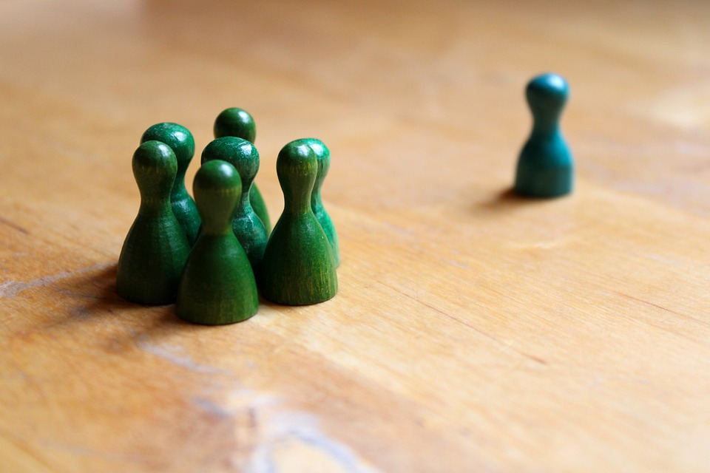
Rollenspiel
Notes:
The role play method is recommended to practise the No Blame Approach. To do this, team up with several colleagues. You can come up with your own scenario or use the following suggestion. If you are not able to play all the roles, take it in turns to play different roles or think together about what this person would say/do.
Role 1: Bullying victim Pupil has been bullied by 3 classmates via mobile phone and in different chats. He/she is very sad, but also very angry. He/she confides in his/her best friend.
Role 2: Best friend
The friend did not know about the cyberbullying. He/she recommends talking to the teacher about it. Either he/she encourages the victim to talk to the teacher him/herself or does this for him/her.
Role 3: Perpetrator
The perpetrator feels ignored by the victim of bullying, is jealous of him/her because he/she is always present at everything, is invited everywhere and he/she is not. He/she decides to write mean messages. Because he/she doesn't want to do it alone, he/she asks friends to join in.
Role 4: Friends of the perpetrator.
They did not want to disappoint their friend and joined in.
Role 5: Fellow students
Have nothing to do with the bullying, but are in the same class/group and can make an important contribution to finding a soluation.
Role 6: Teacher
Tries to find a solution together with everyone by using the No Blame Approach.

Slide 25
Note to multipliers of #ACToncyberbullying
Thank you for addressing this important topic with your group/s.
Visit the project website at www.respact-project.eu to find out more about the project or/and to contact us.

